Slide 1

Healthcare: Persistency of a Drug
Final Project Presentation

Slide 2
Intern Details
Group: Single Member Group
Name: Hassan Faheem
Batch: LISUM06
Email: Hassan_hsn9@hotmail.com
Country: UAE
University: Heriot-Watt University
Specialization: Data Science

Slide 3
Agenda
Executive Summary
Overview
Problem Description
Business Understanding
Data Understanding
Data Intake Report
Exploratory Data Analysis
EDA Overview
Problems in the Dataset
Analyzing Outliers
Skewness & Kurtosis
Correlation Between Target & Features
Data Transformation
Model Training & Testing
Introduction
Classifiers Used
Evaluation of Performance of Classifiers
Classifiers Train & Test Results
Final Recommendation & Conclusion

Slide 4
Executive Summary
The Pharmaceutical Company wants to understand the persistency of a drug. The company has come to the conclusion that the best way to understand the persistency is to automate the whole process. In order to achieve this goal, the company has approached a Company that excels in Analytics. This Analytics Company will automate the process of identifying the persistency in an efficient way.
The goal is to understand the data given, perform the necessary EDA and transformations and then build a classification model that is trained and tested on the given data.

Slide 5
Overview

Slide 6
Problem Description
The problem given here is that the Pharmaceutical Company, ABC is in need to understand the persistency of drug as per the physician prescription. The company ABC has thus approached a company that specializes in Analytics, to get this process of identification to be automated. The company has assigned the case to the relevant member to figure out the solution for the automation of persistency of drug for the company ABC.

Slide 7
Business Understanding
The objective of Pharmaceutical Company, ABC is to understand the persistency of a drug for patients. The data obtained shows a large amount of NTM or Non-Tuberculous Mycobacterial infection. The Company hence wants to verify the persistency of the drug that is being prescribed and so the Company would in turn manufacture more those drugs in demand for a more successful business.

Slide 8
Data Understanding
The Healthcare Dataset provided has 69 columns and 3424 number of observations. The target variable is Persistency_Flag. This variable is of Boolean data type with values that are either True or False. After understanding and analyzing the data, it’s been found that there are few columns that are of numerical data type. Most of the columns are of either Boolean data type or String data type. The column of “Ptid” which refers to Patient ID has no value in terms of model training and thus will be removed the dataset.

Slide 9
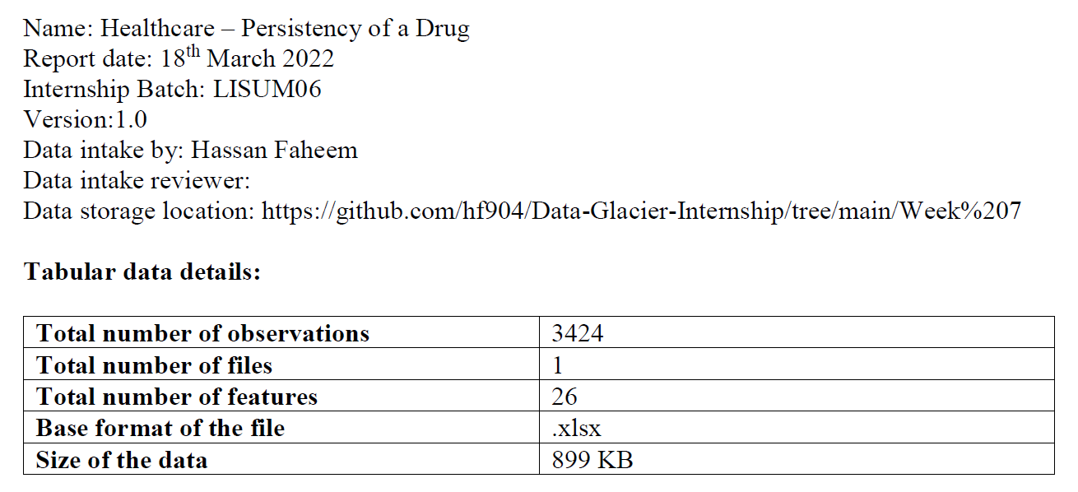
Data Intake Report

Slide 10
Exploratory Data Analysis

Slide 11
EDA Overview
After performing Exploratory Data analysis on the dataset, the results show that most of the columns are of the Boolean data type and have the values of “Y” and “N”. These values will contribute to the model training in their current type and hence were mapped to the values of 1 and 0. Further analysis shows that no Null values were found in the dataset and so did not require any sort of data handling. The analysis show that a certain feature has some outliers and needed to be handled. To fix this, log transformation was performed on this feature to handle the outliers.

Slide 12
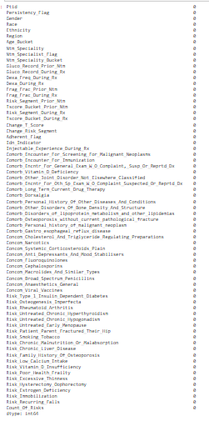
Problems in the Dataset
After analysis, it was found that the dataset has no null values. The function “isnull” was used along with sum function to check and verify the null values in the dataset. The screenshot shows that no null values were found There were some outliers present in the numerical columns of the dataset.

Slide 13
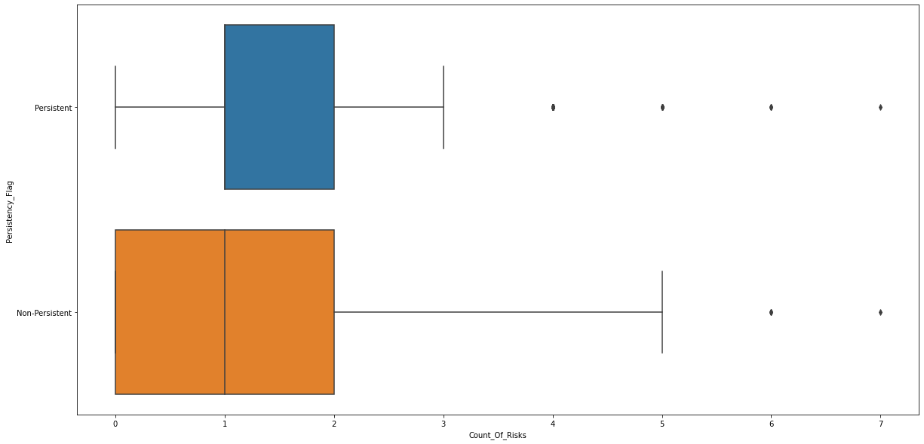
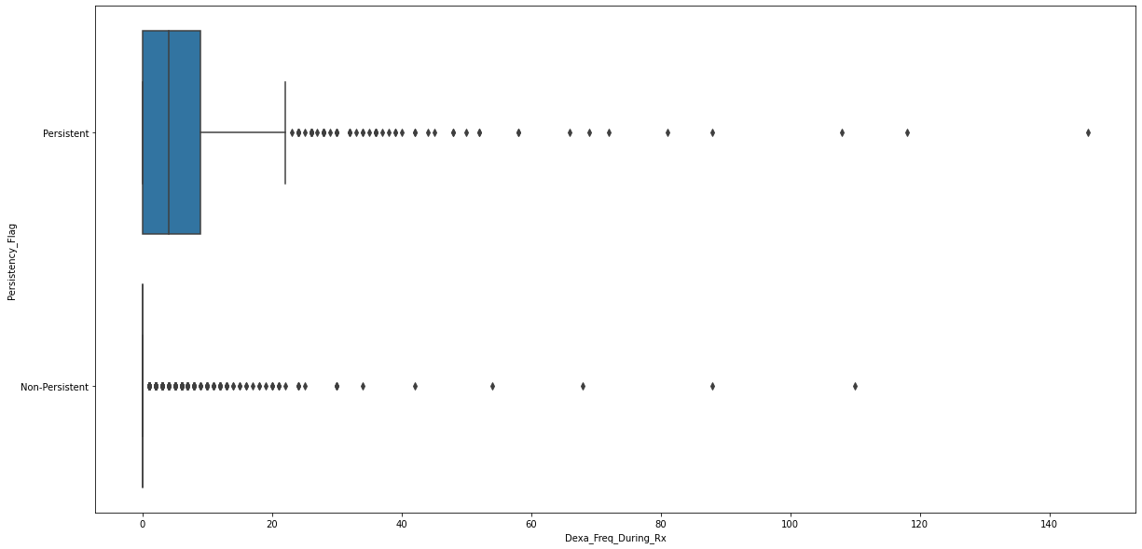
Analyzing Outliers

Slide 14


Skewness & Kurtosis
The figures on the right shows the difference in outliers through skewness and kurtosis in fields of Count_Of_Risks and Dexa_Freq_During_Rx. It can be seen that Dexa_Freq_During_Rx have more skewness and kurtosis which shows that it has more outliers.

Slide 15
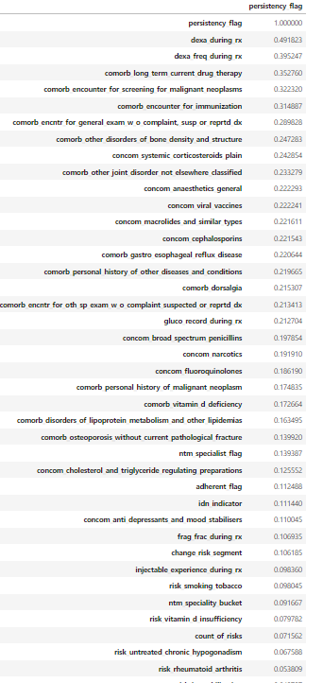
Correlation Between Target & Features
Figure on the right shows correlation between the target value and the features. It can be seen that there are not many features that are highly correlated with the target value.

Slide 16
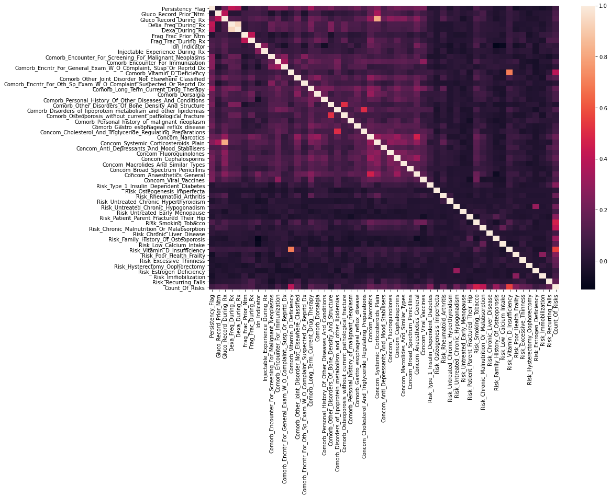
Dependency of Data Features
The Figure on the right shows the correlation between all the features. It can be seen from the figure that the features that are less correlated are in darker color while the features that are highly correlated are in lighter color.

Slide 17
Data Transformation
Null Values: The dataset did not have any Null values present after the analysis and thus no step was taken in this transformation step.
Outliers: In the numerical features of the dataset, there were outliers present which were shown by the skewness and kurtosis. The function RobustScaler was used to scale the values and the next step is to remove the outliers present and this is done by calculation the inter-quartile range and removing the values with lie outside the whiskers. This step changes and decreases the shape of the data from (3424, 69) to (2964, 69).
Changing data type: The dataset had a lot of columns with the Boolean values of “Y” and “N”. For the purpose of model training, all the values of “Y”, “N” and of the target feature “Persistent”, “Non-Persistent” were changed to [1,0].
Unbalanced Dataset: Unbalanced dataset was the next issue faced and this unbalanced dataset will in turn affect the prediction results. Hence to counter this unbalancing issue, Up Sampling method was used. This method will bump up the records of the class with minority and thus will make all the records equal in count.
One-Hot Encoding: The final step in the data transformation was the implementation of the function get_dummies which was used for the purpose of One-Hot Encoding. The numerical values are needed for the classifiers to work on and so by this method, the values are transformed into numerical values which can be used by the classifiers.

Slide 18
Model Training & Testing

Slide 19
Introduction to Model Testing & Training
As seen from the figures of the previous section, its clear that not many features are highly correlated with the target value. Therefore, to avoid any overfitting, it would be in the best interest to ignore the less correlated features during the model training section of the project which comes after this. In the model training section, the dataset in divided into two section with 70% data for training the model and 30% data is given for testing the model.

Slide 20
Classifiers Used
There are Classifiers used from each of the family of Models which include Linear Models, Ensemble & Boosting Models and Neural Network. The following are the classifiers that were trained and tested on:
Ensemble & Boosting Models
Bagging Classifier
Gradient Boosting Classifier
Random Forest Classifier
ExtraTrees Classifier
AdaBoost Classifier
XGBoost Classifier
Stacking Classifier

Slide 21
Classifiers Used - Continued
Linear Models
Ridge Classifier
SGD Classifier
Logistic Regression Classifier
Neural Network
Multi-Layer Neural Network
Multi-Layer Perceptron

Slide 22
Evaluation of Performance of Classifiers
To evaluate the classifier models and select the best classifier, there are various methods that can be used. For this project, the following matrices are used to evaluate the classifiers:
Accuracy
Recall
Precision
F1-Score
Confusion Matrix
ROC

Slide 23
Classifiers Train & Test Results
The following table shows the results of Ensemble & Boosting Models
Classifier | Accuracy
Bagging Classifier | 0.80
Gradient Boosting Classifier | 0.73
Random Forest Classifier | 0.79
ExtraTrees Classifier | 0.79
AdaBoost Classifier | 0.78
XGBoost Classifier | 0.77
Stacking Classifier | 0.80

Slide 24
Classifiers Train & Test Results- Continued
The following table shows the results of Linear Models
Classifier | Accuracy
Ridge Classifier | 0.79
SGD Classifier | 0.78
Logistic Regression Classifier | 0.78
The following table shows the results of Neural Network
Classifier | Accuracy
Multi-Layer Neural Network | 0.79
Multi-Layer Perceptron | 0.76

Slide 25
Final Recommendation & Conclusion
From the previous slides it is clear that the following classifiers gave out the best results:
Bagging Classifier
Stacking Classifier
Ridge Classifier
By taking into consideration all the mentioned evaluation metrices in the previous slides, it can be seen that Stacking Classifier gives slightly better result than Ridge Classifier and Bagging Classifier.

Slide 26
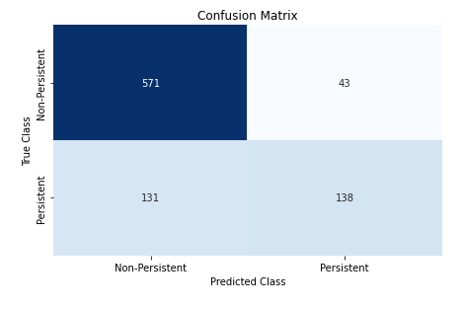
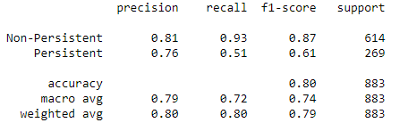
Final Recommendation & Conclusion- Continued
The figures below shows the evaluation metrices of the Classifier and the Confusion Matrix of the classifier selected.

